Slide 1
Preliminary Design Review
Team 28 | SharkCam
Liron Dubin | Kevin Vasquez | Sophia Delia | Brett Senders | Alex HP

Slide 2
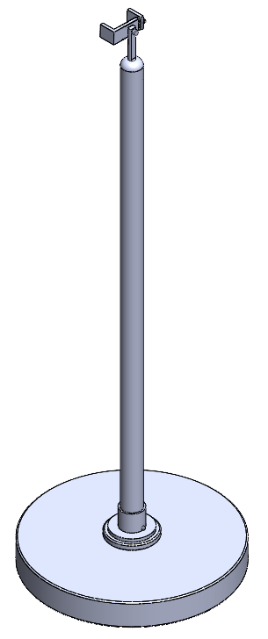
SharkCam
Camera accessory for Shark Vacuum Robot to autonomously capture photos at events and parties
Phone Holder
Column Assembly
SharkNinja Robot
Notes:
Liron

Slide 3
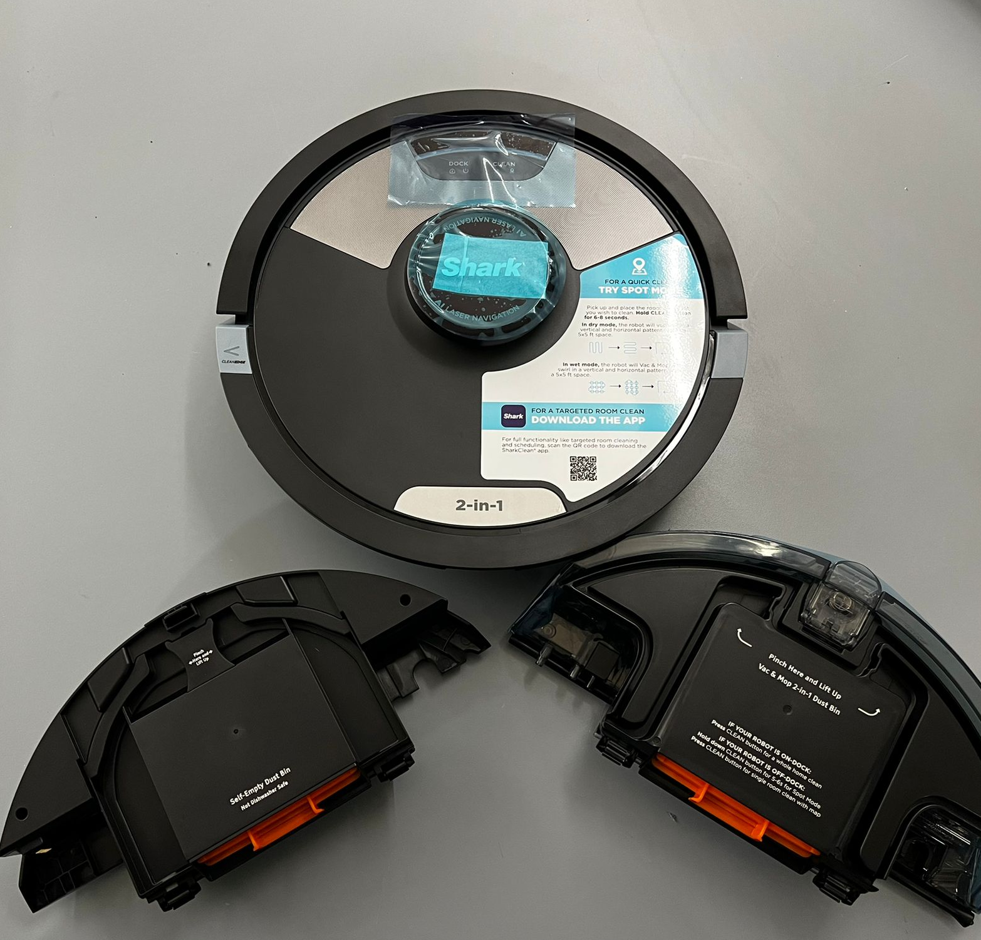
Problem Statement
Shark Ninja wants accessories for their vacuum robot to expand its functionality beyond cleaning
There is increasing demand for fun ways to capture photos at events and parties
Consumers need the ability to capture photos hands free and share media in a central location
Notes:
Brett

Slide 4
Requirements
Deliverables
Roam around mapped event area and capture photos at timed interval autonomously
Can handle collisions
1 hr battery life
Non destructive to robot
Tooless assembly for user
Camera column + phone mount
Collision detection system
Electronics module
Web app
Media server
Notes:
Liron

Slide 5
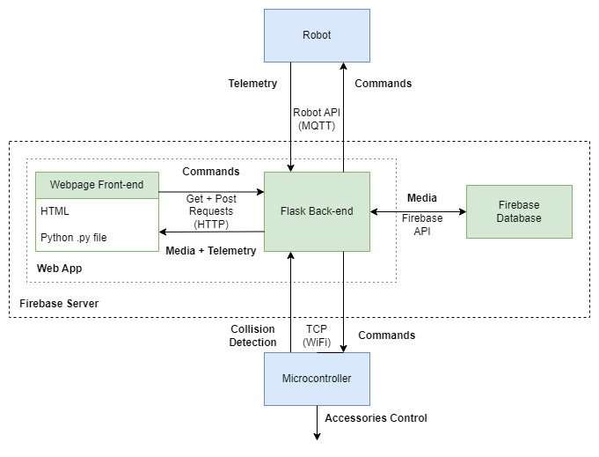
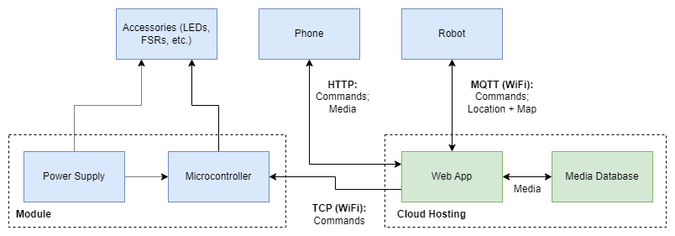
Block Diagrams
Networking Block Diagram
Full System Block Diagram
Notes:
Brett

Slide 6
Robot Behavior
Start command from web app triggers robot’s autonomous cleaning mode
Vacuum will be turned off
Cleaning mode allows for autonomous navigation
At user defined interval, robot stops, phone captures image, robot turns in place, phone captures image, repeats
Robot resumes autonomous navigation routine
User inputs:
Photo Capture Interval - Length of time between when each photo is taken
Number of Photos Captured Per Interval - Number of photos taken at each location
Time Spent Taking Photos - Time spent capturing photos before robot returns to base
Scan Room Command - Maps room for autonomous navigation
Notes:
Brett

Slide 7
Networking and Electronics Overview
Framework: Flask
Front End
HTML for basic design elements (buttons, site navigation, etc.)
CSS for styling
Back End
Currently: locally hosted Flask server
At time of deployment: Hosted by Firebase cloud server
Server will be containerized
Media Database: Firebase
Robot Controls
Python Library (provided by SharkNinja)
MQTT Server (hosted by Robot)
Microcontroller (for collision detection)
Photo Access
Each event has unique ID assigned
User inputs ID on “Photo Viewer” page to access their photos
Notes:
Soup’s Slide

Slide 8
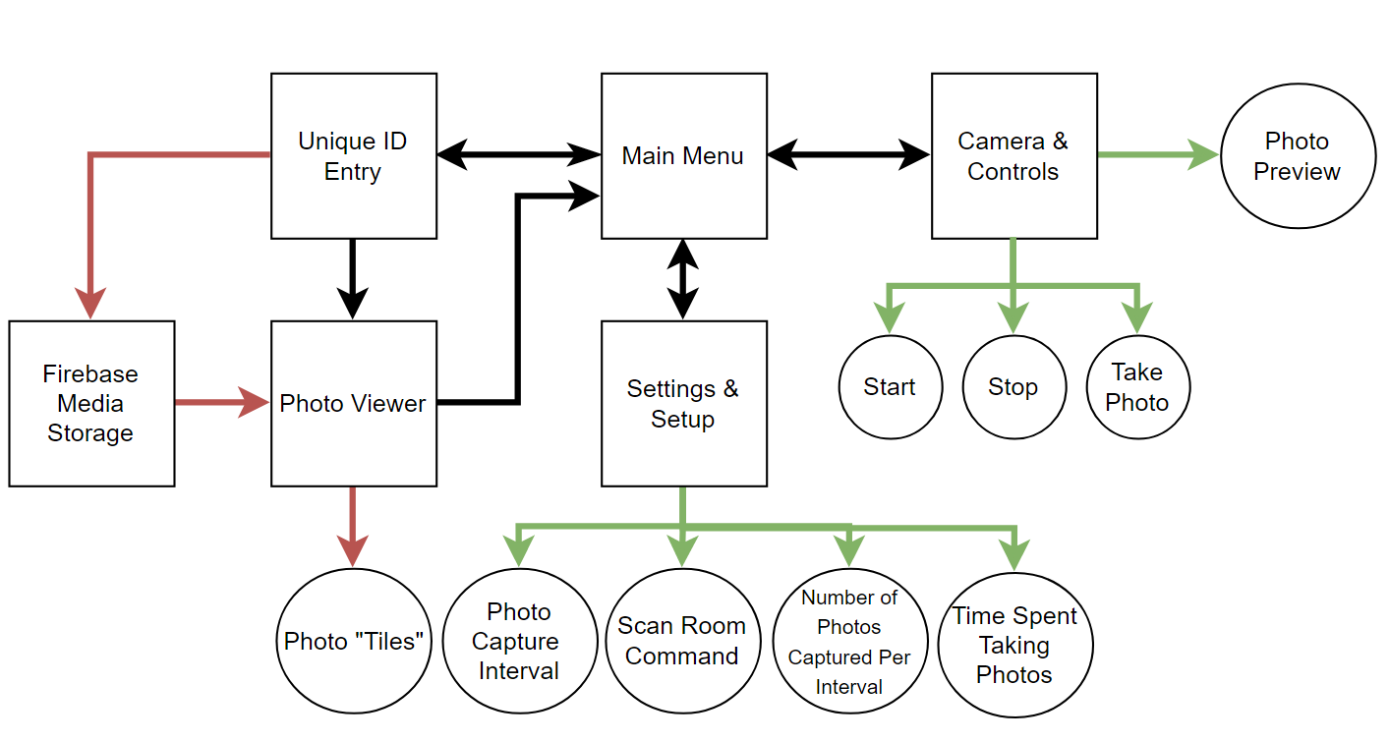
High Level Site Layout and Media Access
Legend:
Interactive Elements
Webpages
Media Access
Notes:
Soup’s Slide

Slide 9
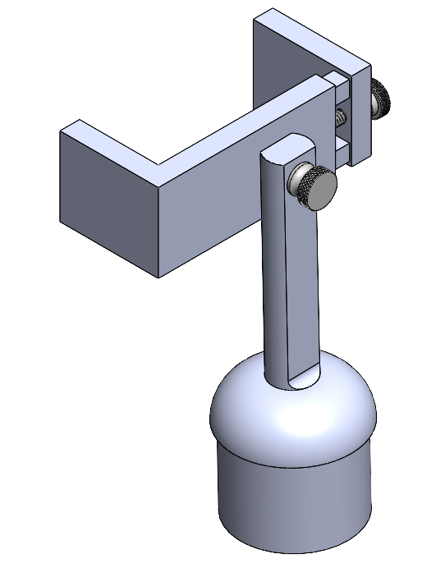
Camera Column Assembly
Electronics Module
Phone pieces
Semi-permanent 3D printed base
3M VHB adhesive to attach to robot (non-destructive)
ABS column
Detachable from base
LED indicators to show robot status
Force sensors
Phone holder
Two pieces to hold phone
One mount to interface with tube
Mount interface
Gutted dust-capture module (dustcup)
Can’t interfere with sensors or robot won’t operate
3D printed mounts for ESP, battery, breadboard
Notes:
Kevin

Slide 10
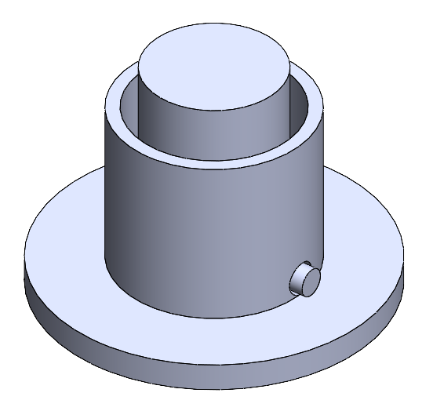
Column Quick Release (Semi-Permanent Base)
Tube Insert
Consists of three components:
Tube Insert (mated to tube with Epoxy)
Spring Button
Tube Base
Tube Base
Spring Button
Notes:
Kevin

Slide 11
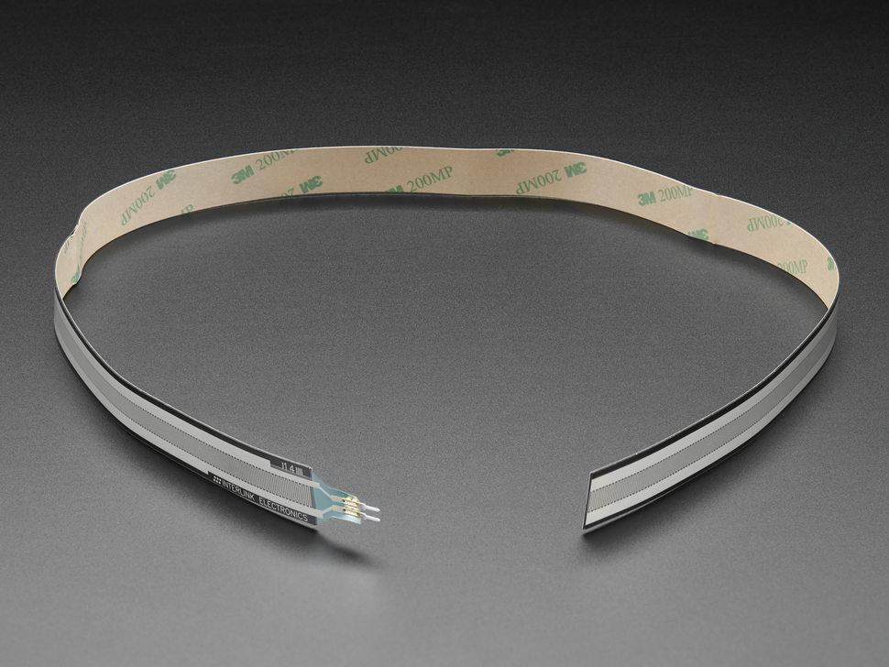
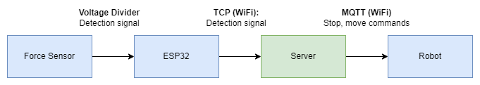
Collision Detection
Need system to stop robot if column hits something
Interlink force-sensitive resistor (FSR) attached to column
ESP32 microcontroller
Server sends commands to robot:
Stop
turn 90 degrees
resume
Notes:
Brett

Slide 12
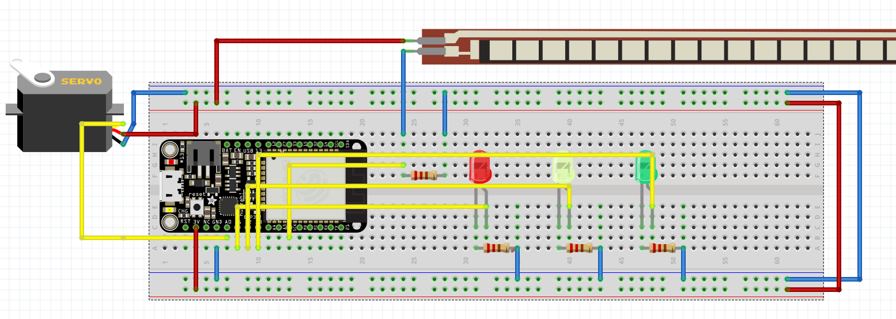
Breadboard view of the schematic
Notes:
Alex
Servo, Force sensor, led’s, microcontroller

Slide 13
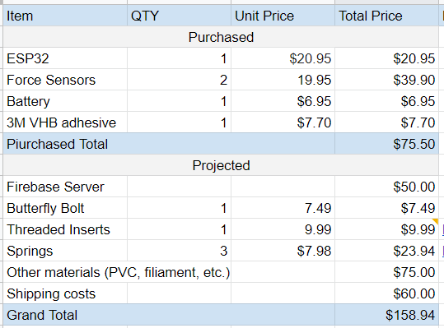
Budget
Notes:
Alex (Brett?)

Slide 14
Potential Challenges
How to handle collisions with the phone/phone holder
How to make column collapsible if possible
Modifying module without interfering with sensors and dust emptying
How to get location data from robot to link with photos
Implementing Robot API with limited documentation
Notes:
Liron

Slide 15
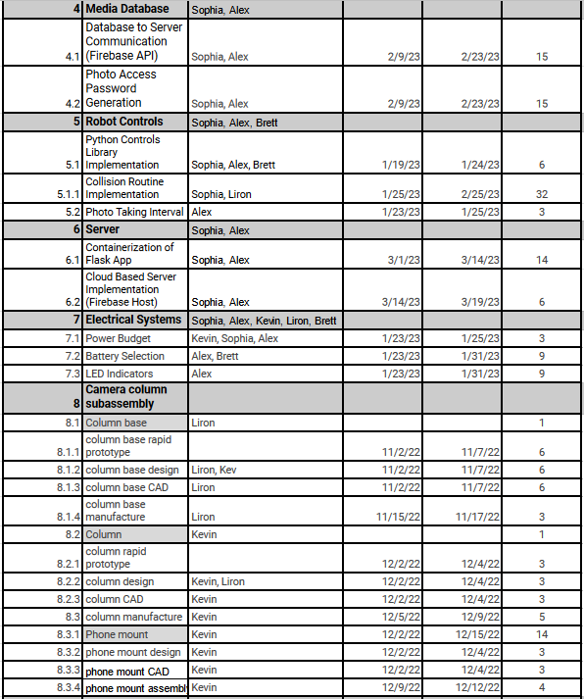
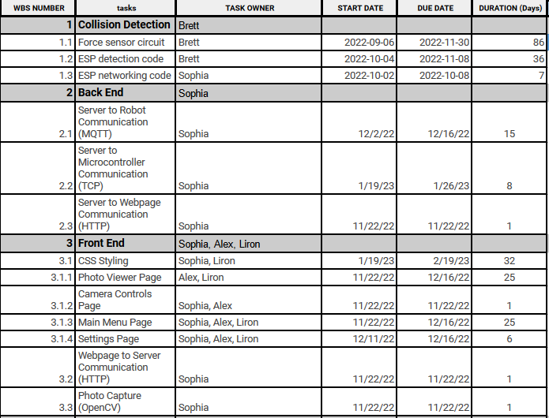
Schedule
Notes:
Alex

Slide 16
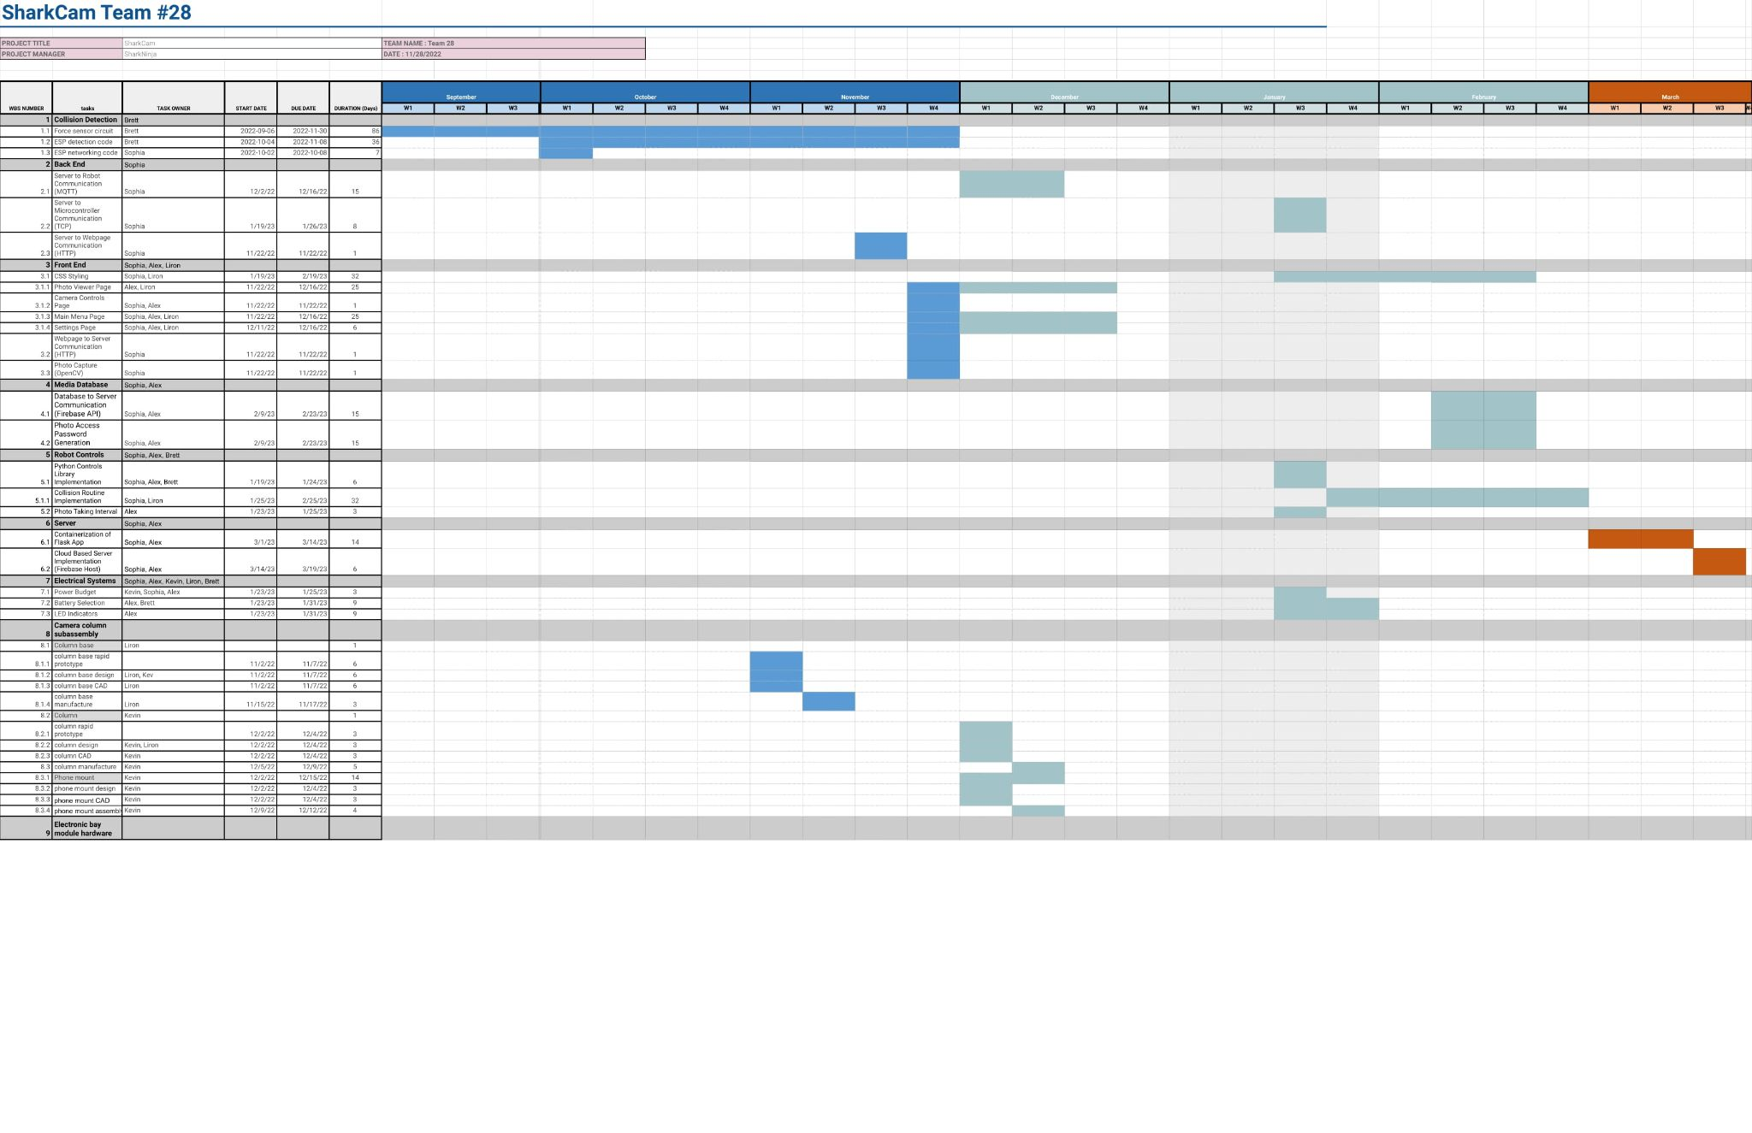
Notes:
Alex

